Slide 1

Intro to Data for Data Science
Matthew Renze
Data Science Consultant
matthewrenze.com
Notes:
Hi. I'm Matthew Renze, data science consultant, author, and public speaker.
Welcome to this introductory course on data for data science.
In this course, we'll learn about data as a foundation for data science.
We'll learn what data is, why it's important, and how it is used within data science.
In addition, we'll learn about data types, data structures, tabular data, and the data life cycle, all from the perspective of data science.
But first, let's begin with a quick story.

Slide 2
The Rise of Data
Notes:
Data… a collection of symbols representing the quality or quantity of a physical phenomenon.

Slide 3

Notes:
Humans have likely been using data for as long as we’ve been counting on our fingers.

Slide 4
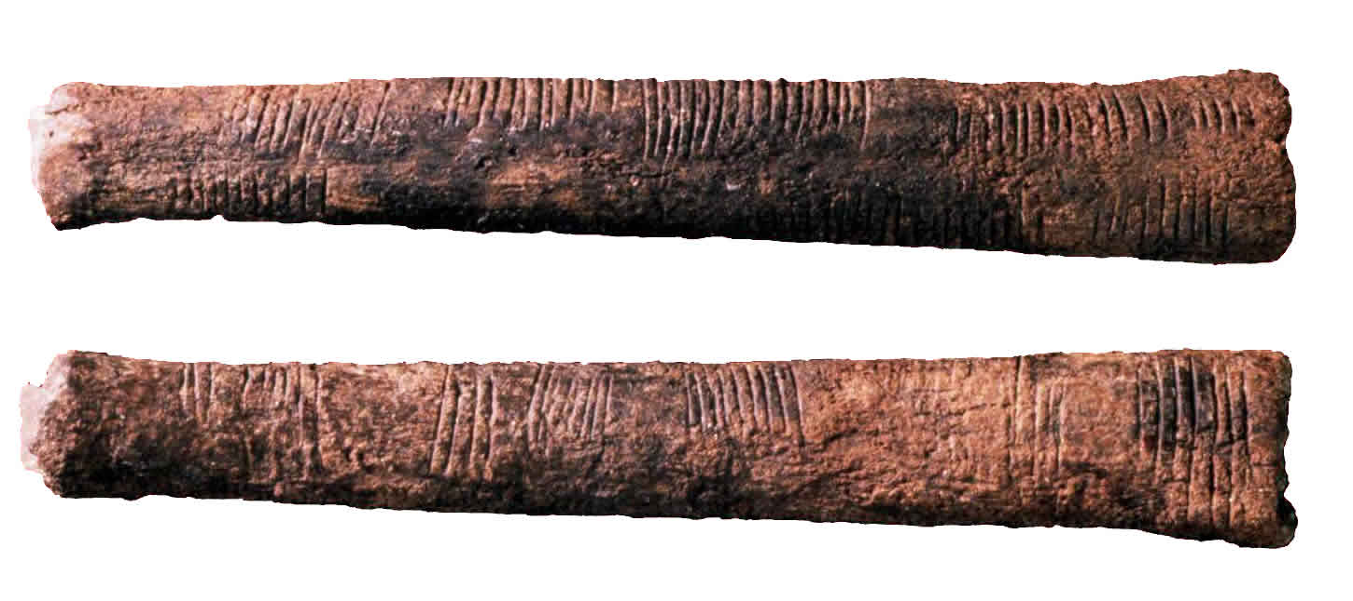
Source: Museum of Natural Sciences in Brussels, Belgium
Notes:
We have evidence of humans carving notches into wood, bone, and stone to count days, lunar cycles, and animals for at least the past forty-thousand years.

Slide 5
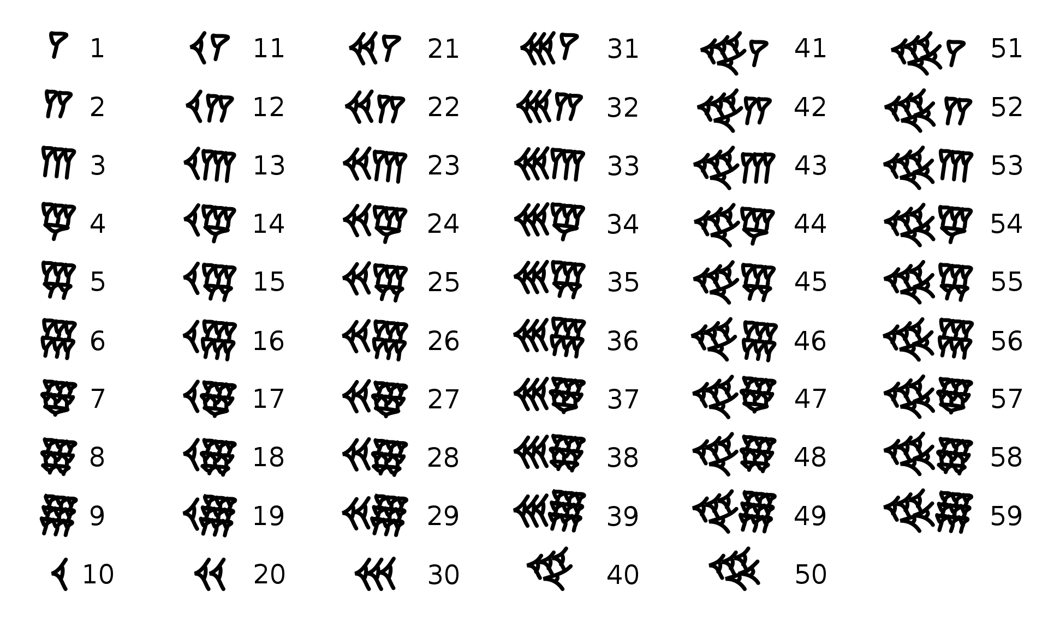
Source: Wikipedia: Babylonian Numerals
Notes:
A few millennia ago, the Sumerians, Egyptians, and Chinese were recording written counts of items, animals, people, and astronomical observations.

Slide 6
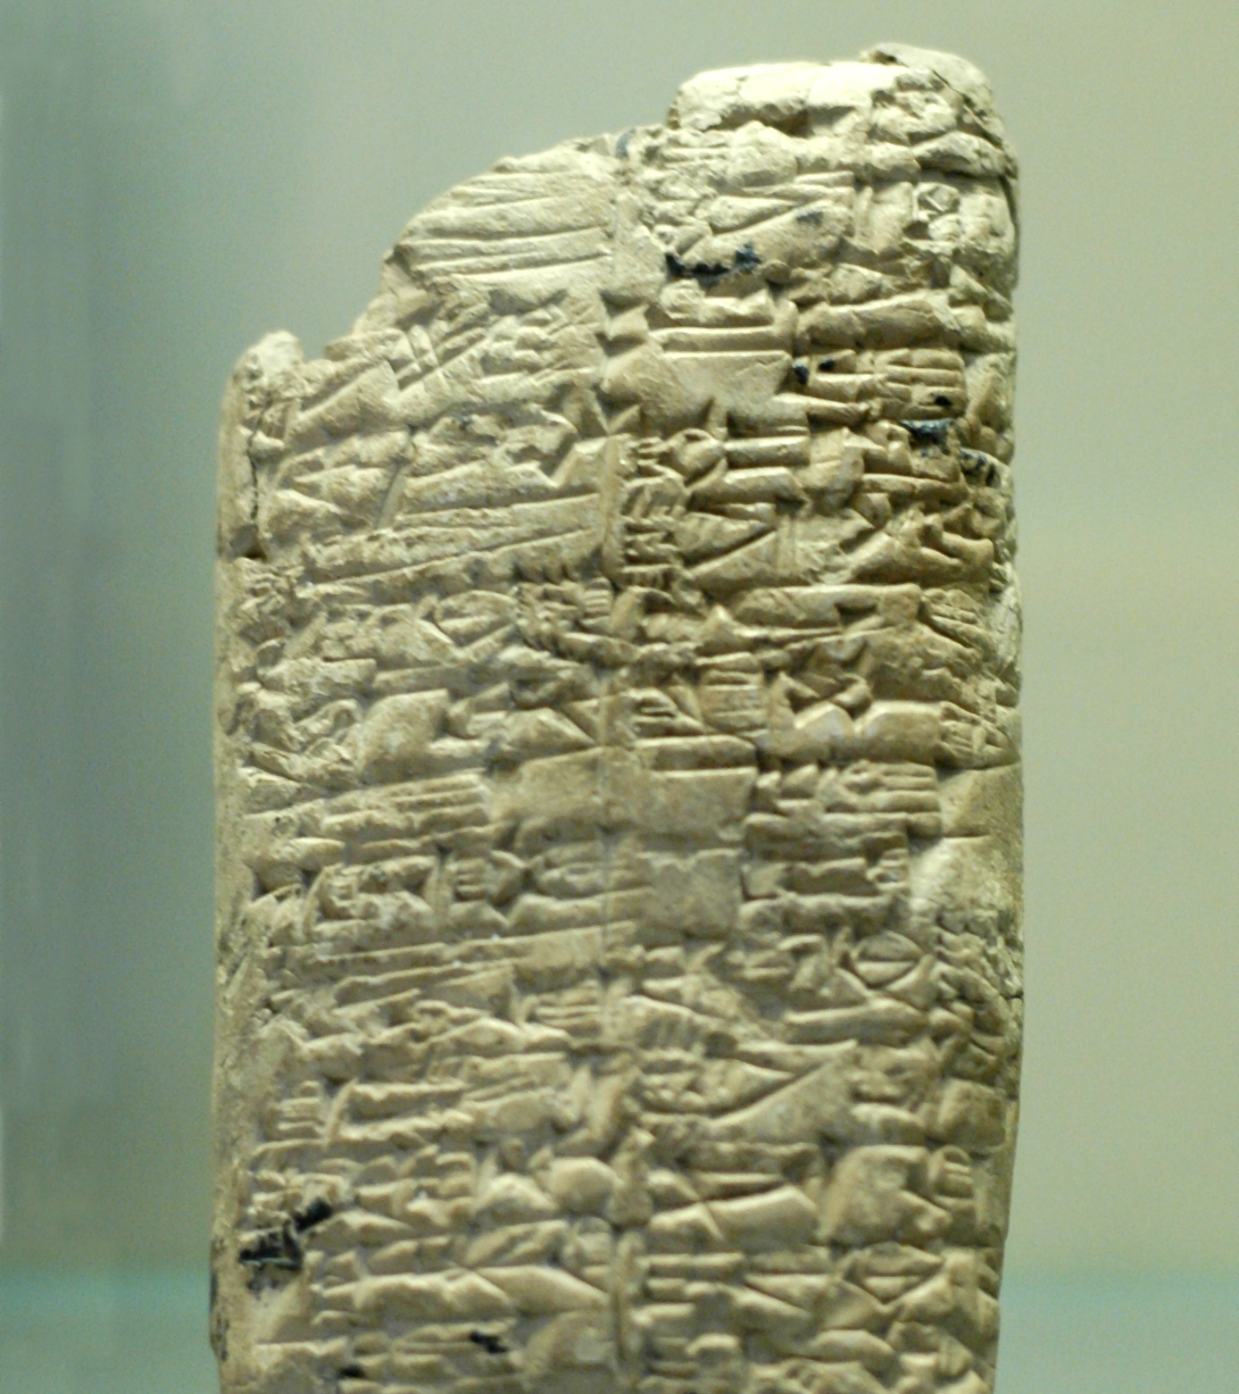
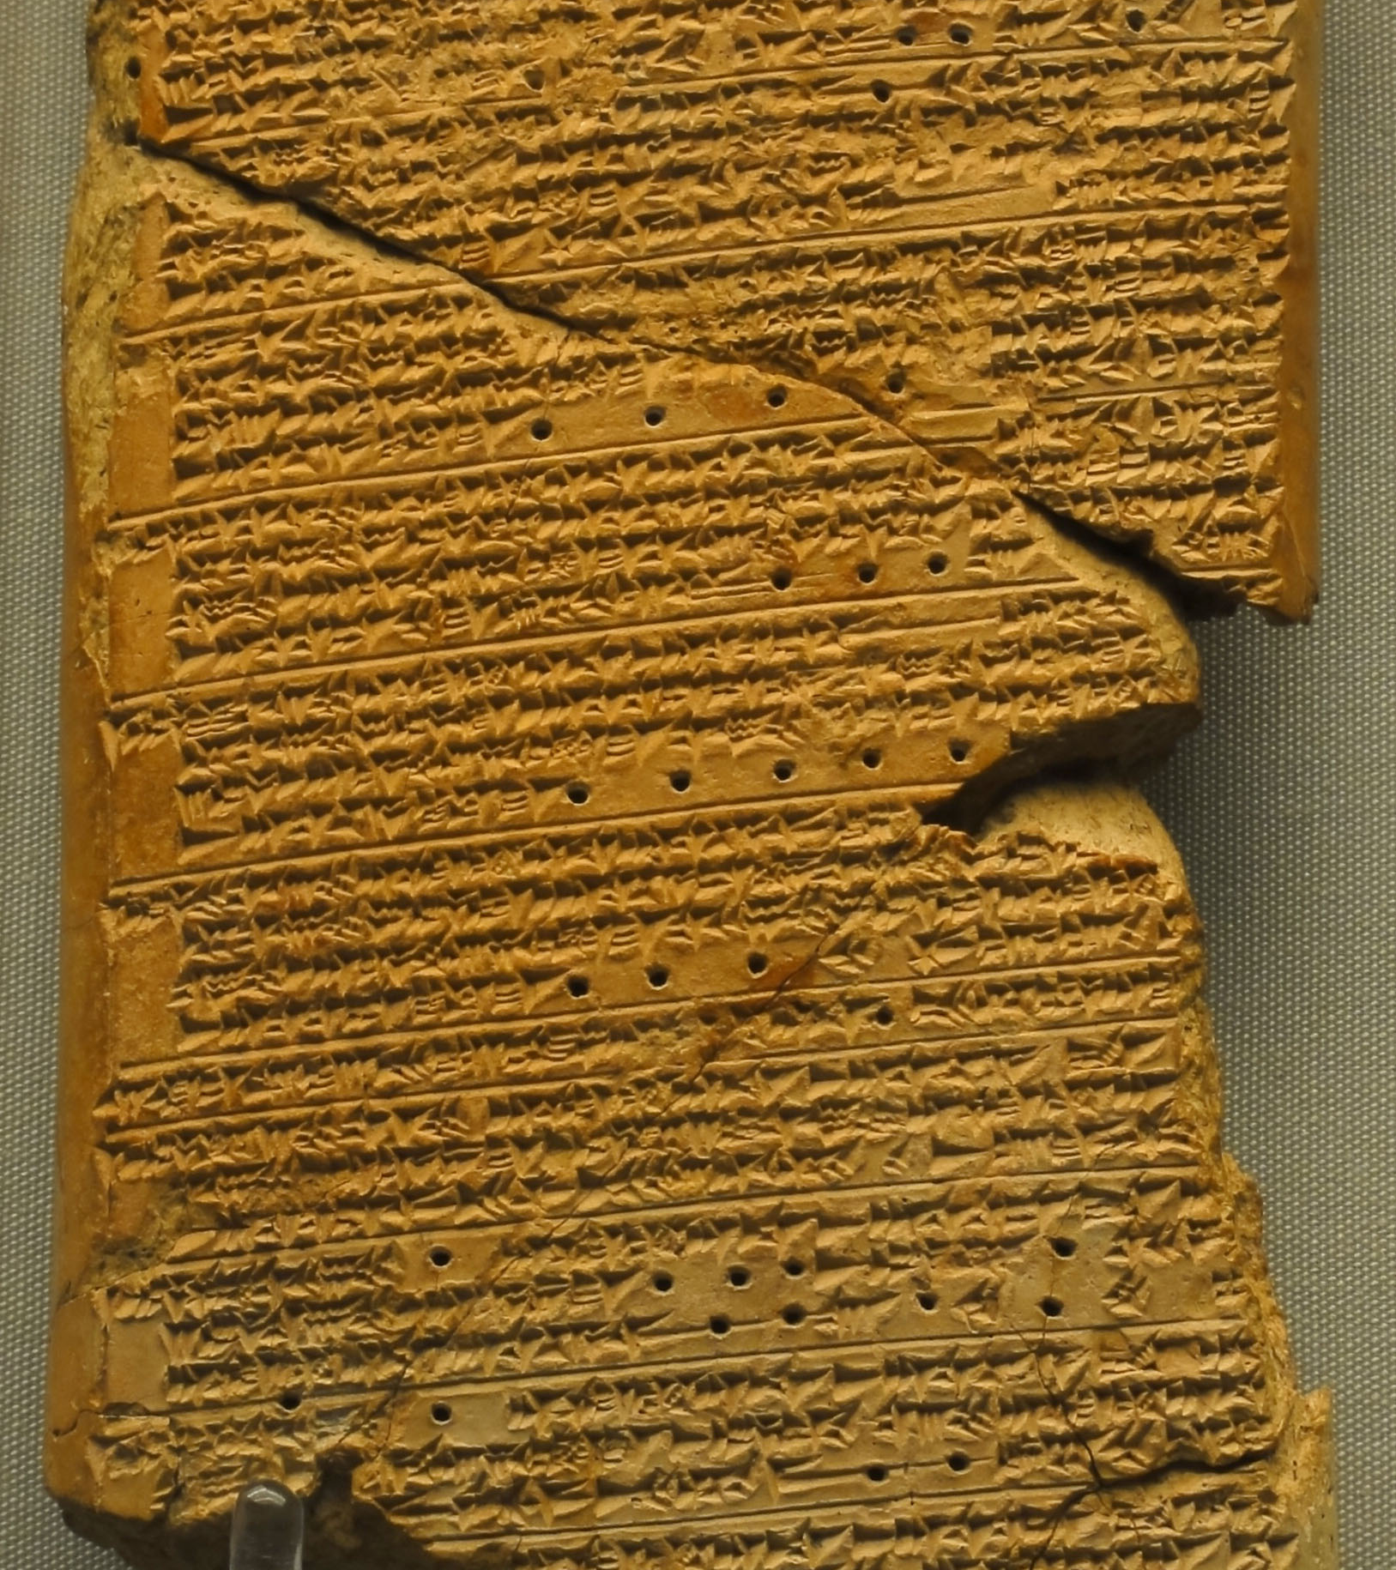
Source: Wikipedia -Venus tablet of Ammisaduqa
Notes:
They recorded these data using clay tablets, papyrus, and parchment, using early writing systems like cuneiform, hieroglyphics, and logographs.

Slide 7
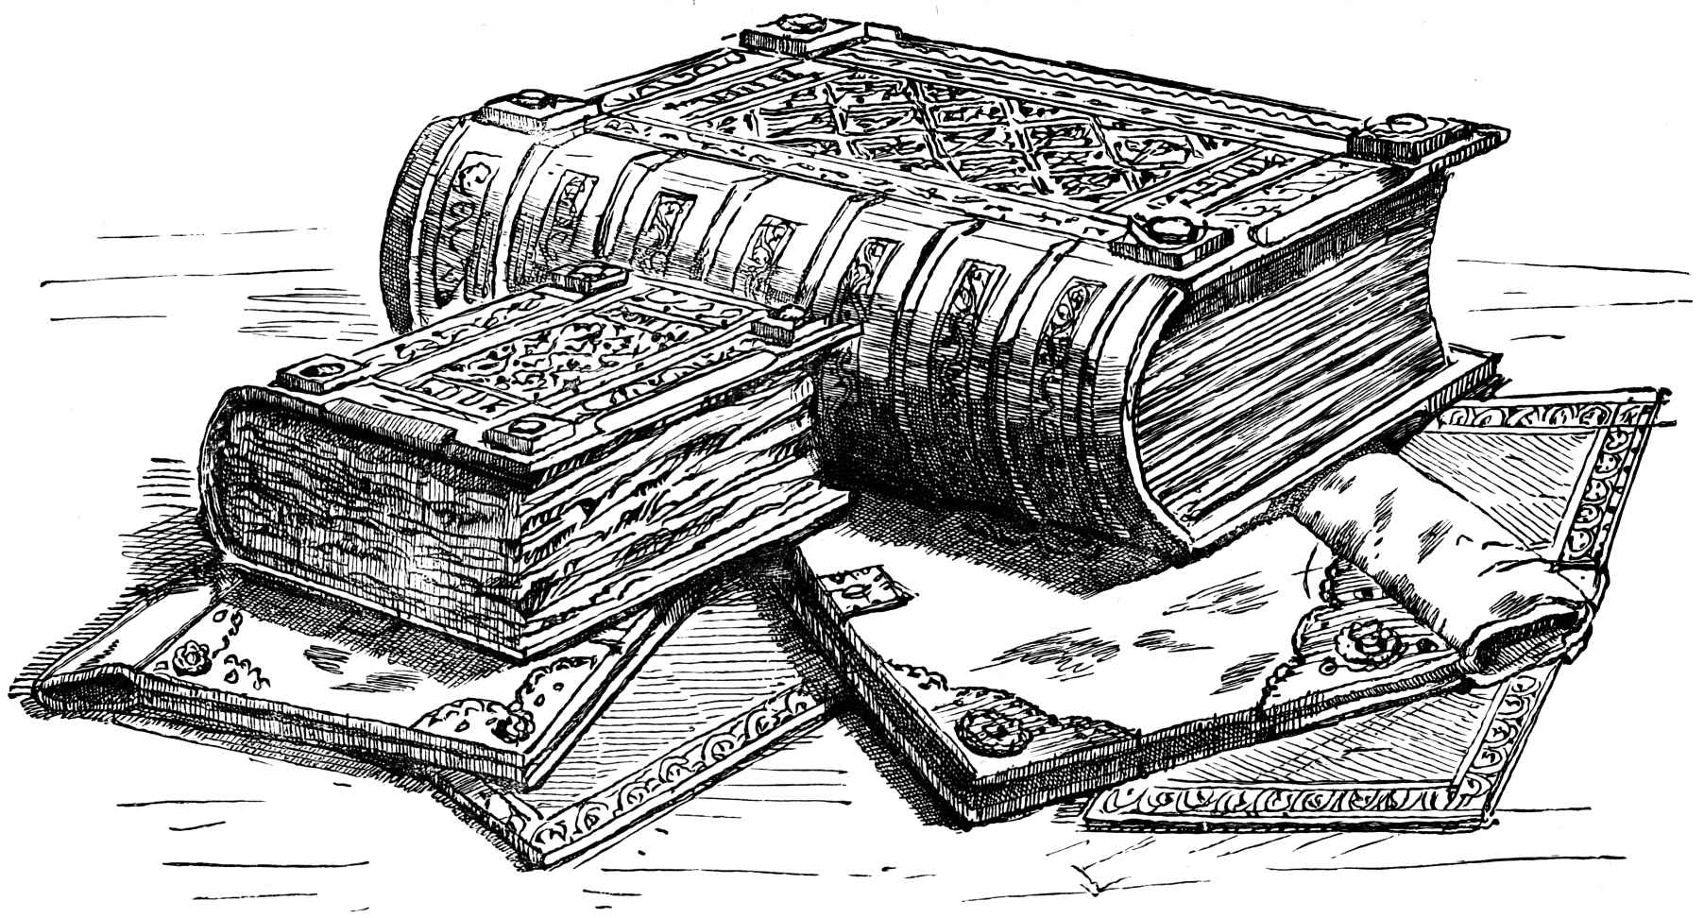
Notes:
A few centuries ago, data were collected by governments for census and taxation, or by businesses for accounting, inventory, and transactions.

Slide 8
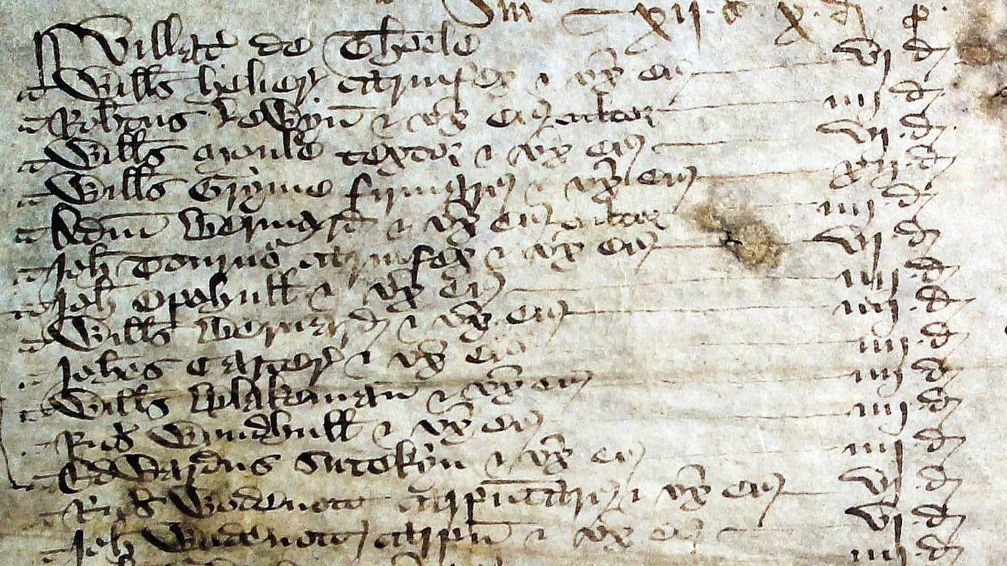
Source: Polltax Return, Hampshire, 1379
Notes:
Data at this point in history were recorded largely using quill pens in paper ledgers.

Slide 9
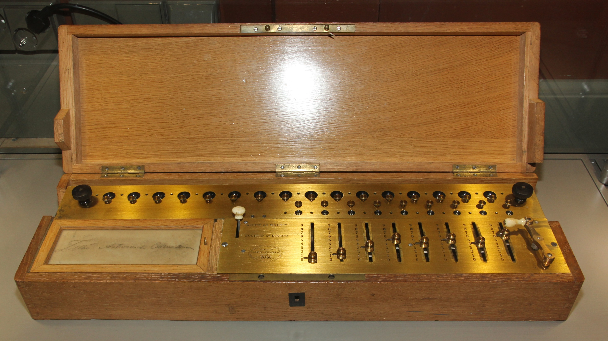
Notes:
In the 1800s, mechanical computers radically sped up data processing and ushered in a new area of data analysis.

Slide 10
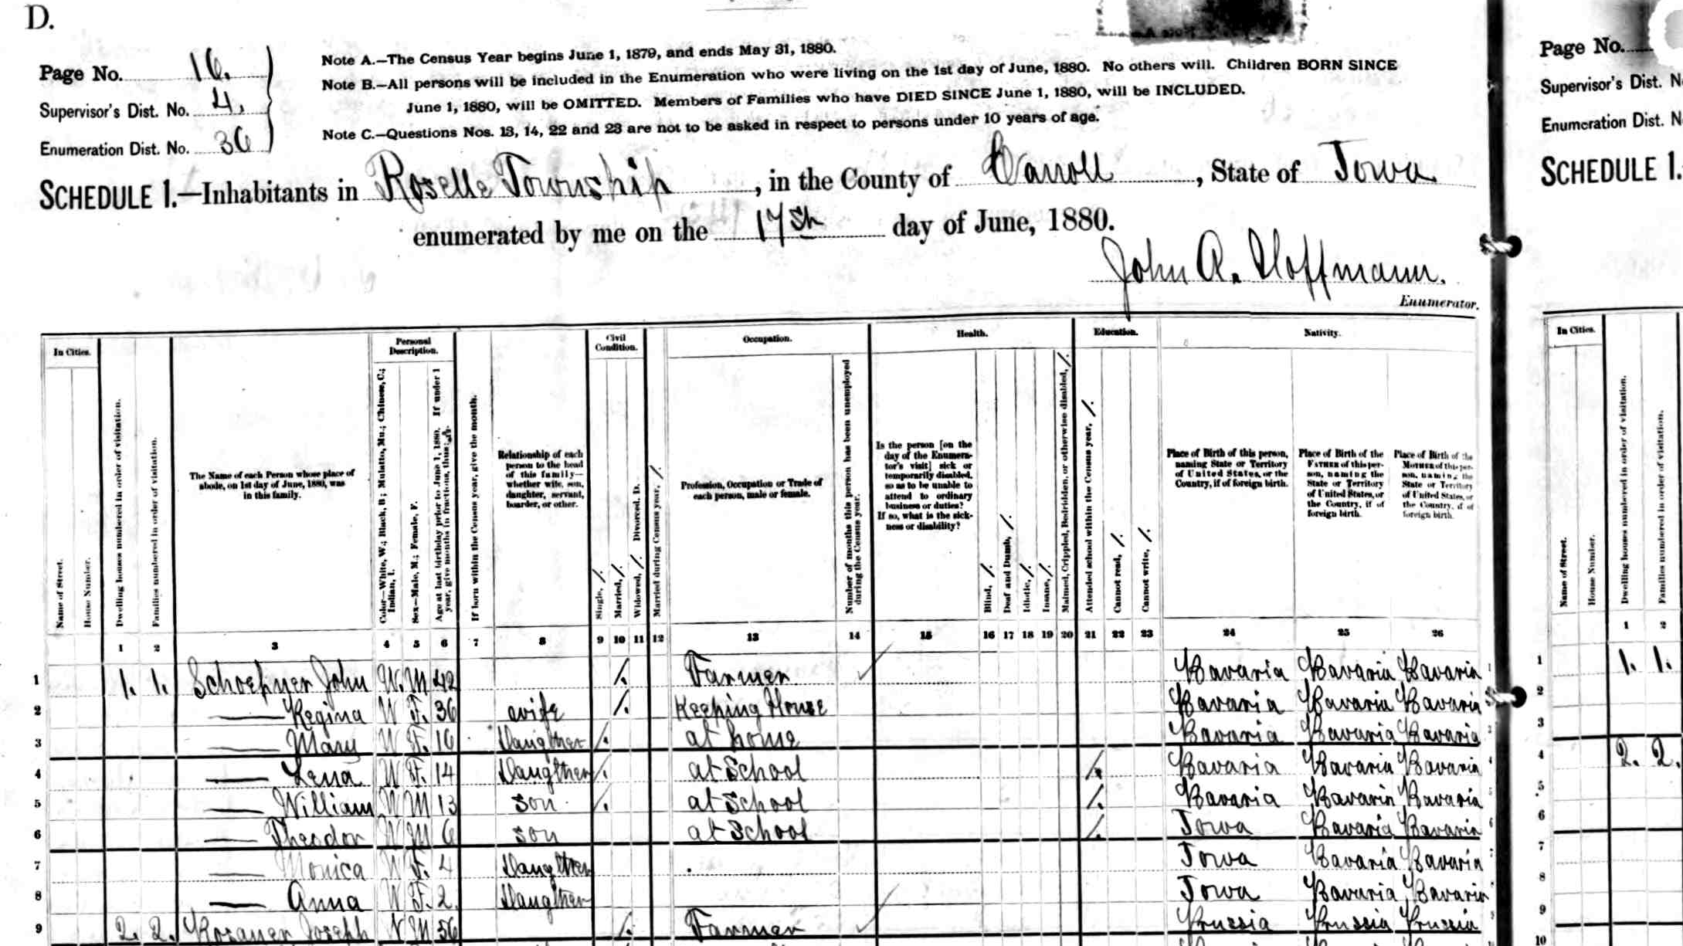
Notes:
For example, the 1880 US census took over 7 years to process and analyze without a computer.

Slide 11
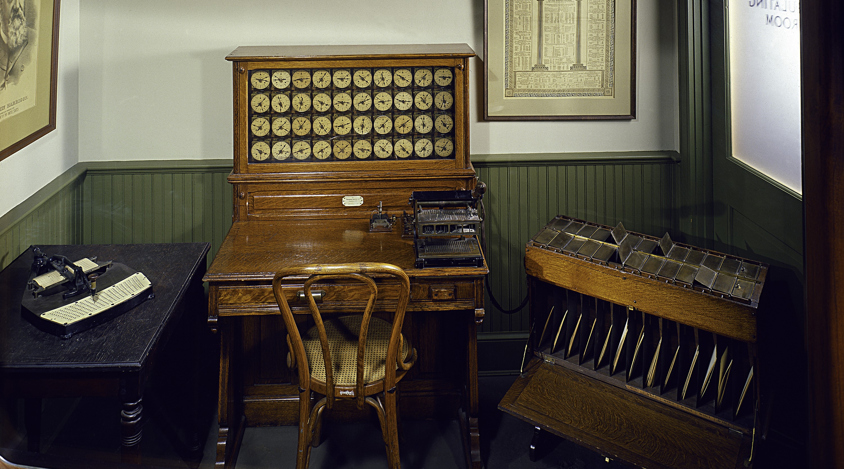
Source: Smithsonian National Museum of American History
Notes:
However, the 1890 US census, took only 18 months thanks to Herman Hollerith’s punch-card-based “Tabulating Machine”.

Slide 12

Source: US Army
Notes:
In the 1900s, electrical computers dramatically increased both data storage and processing capabilities.

Slide 13
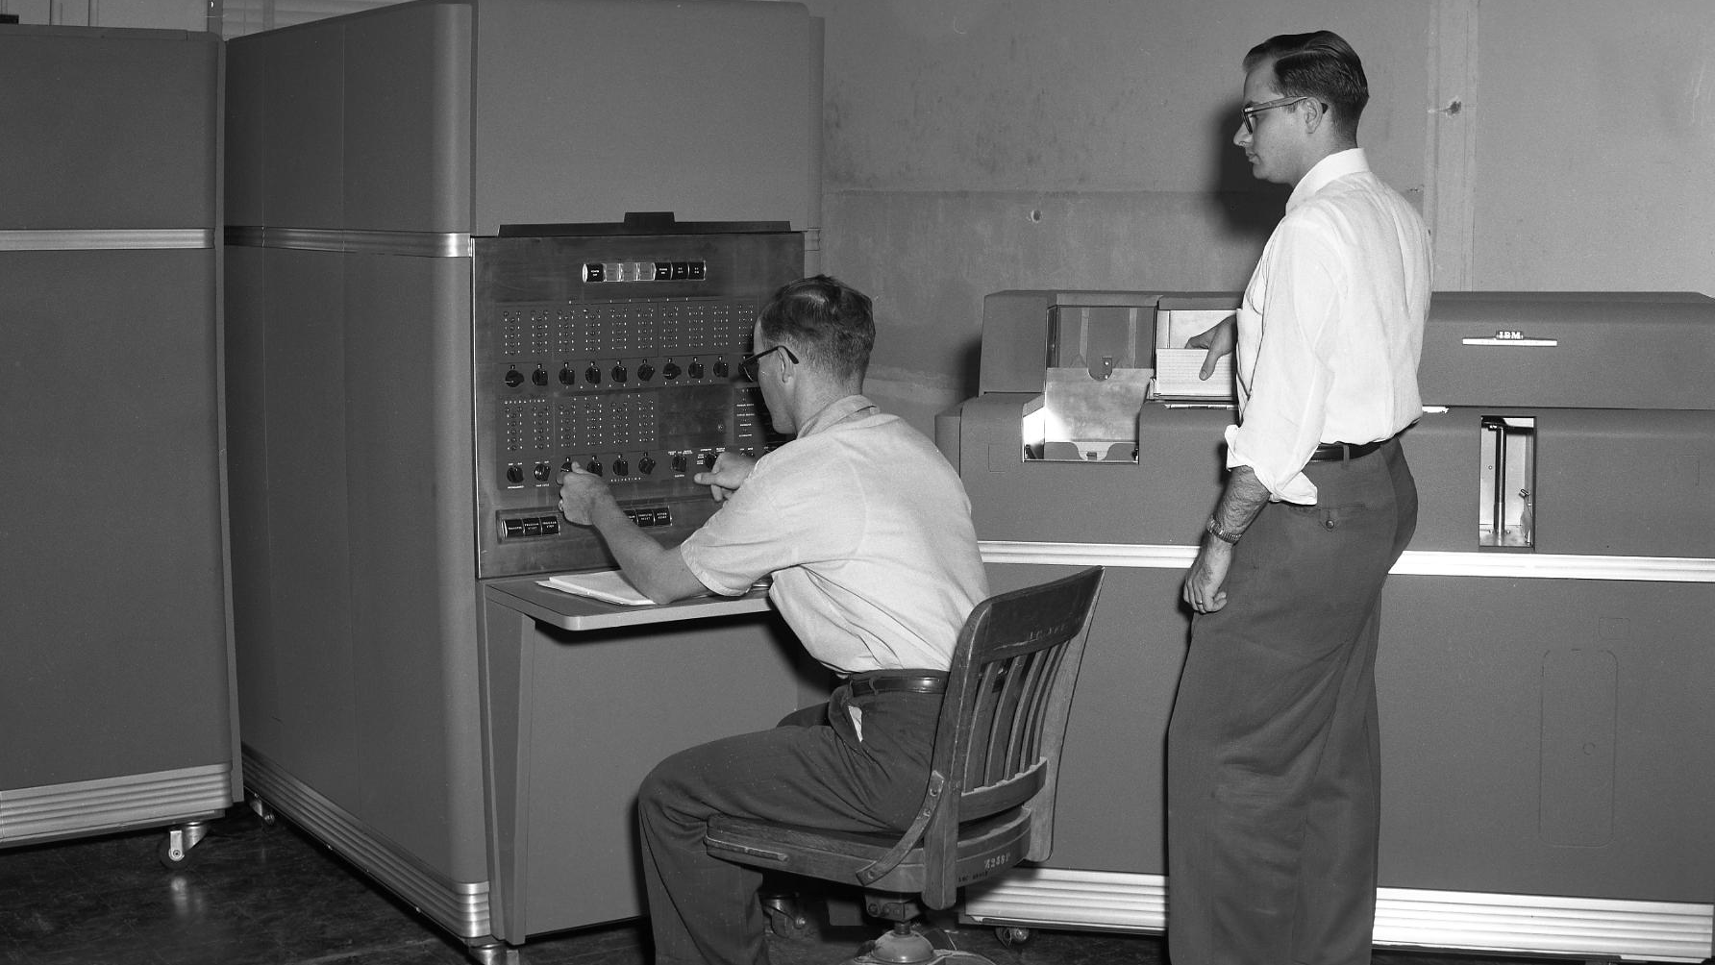
Source: Texas A & M
Notes:
By the mid-1900s, digital computers allowed us to store and analyze data as bits of information encoded as ones and zeros.

Slide 14
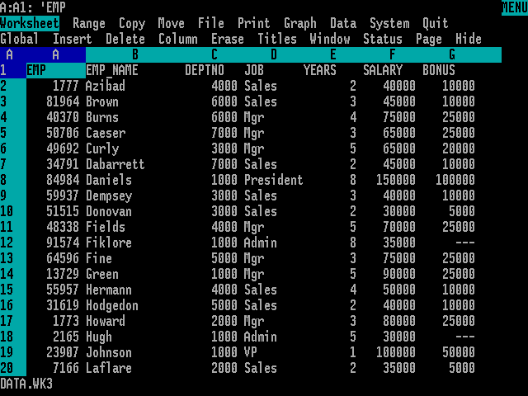
Source: Odacir Blanco
Notes:
In the 1980s, the emergence of relational databases allowed us to efficiently store and process transactional data.

Slide 15
SELECT ID, Last_Name, First_Name, Hire_Date
FROM Employees
ORDER BY Hire_Date
WHERE Department_ID = 10
ID First_Name Last_Name Hire_Date
----------- ---------- --------- ---------
37 Bill Smith 1980-08-02
28 Miko Chen 1982-04-12
51 Amy Lopez 1985-09-10
Notes:
We also saw the emergence of programming languages like structured query language which allow us to rapidly query and analyze data.

Slide 16
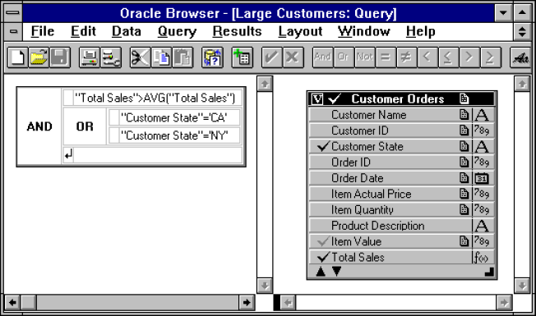
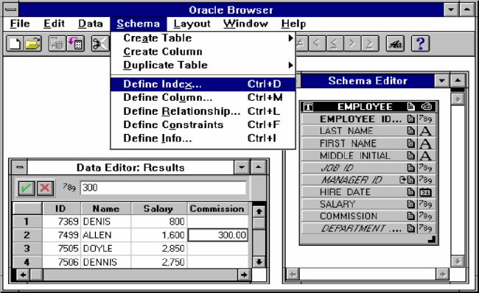
Notes:
In the 1990s, data warehouses, data marts, and data cubes were used to store and analyze ever-larger growing sets of data.

Slide 17
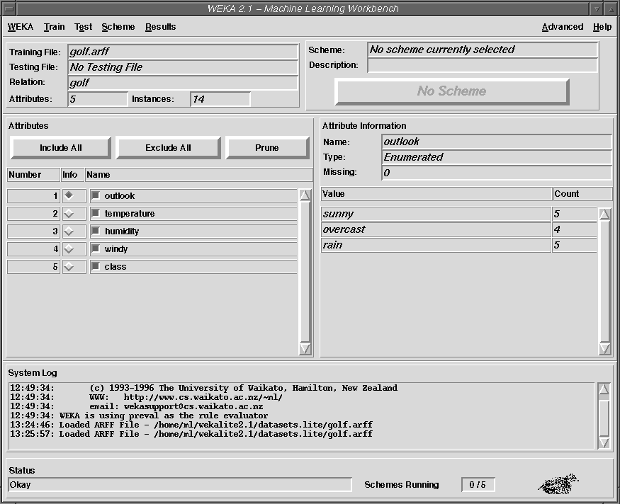
Notes:
We also saw the emergence of data mining to allow us to discover patterns of interest in large data sets.

Slide 18
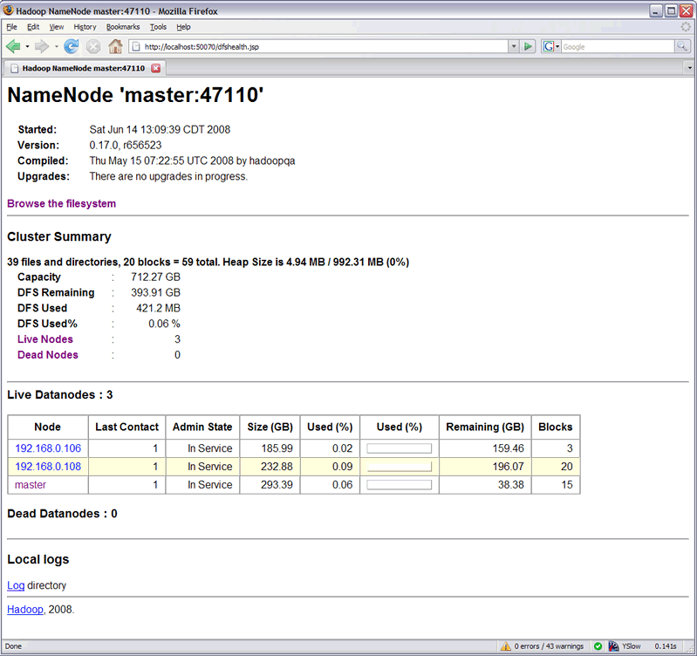
Notes:
In the 2000s, big-data platforms emerged to handle very large data sets by spreading data and processing across several computers in a cluster.

Slide 19
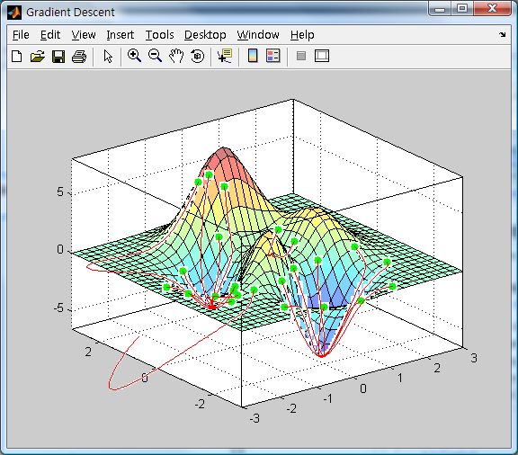
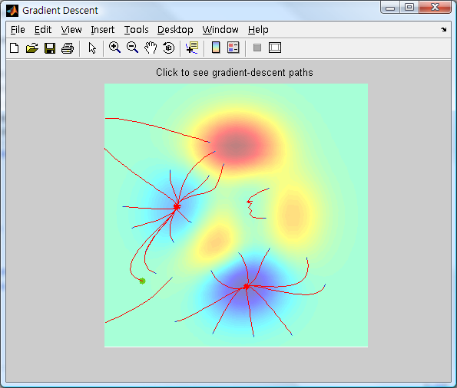
Notes:
We also saw the rise of machine learning – training computer algorithms on large sets of data to classify new data and make predictions.

Slide 20
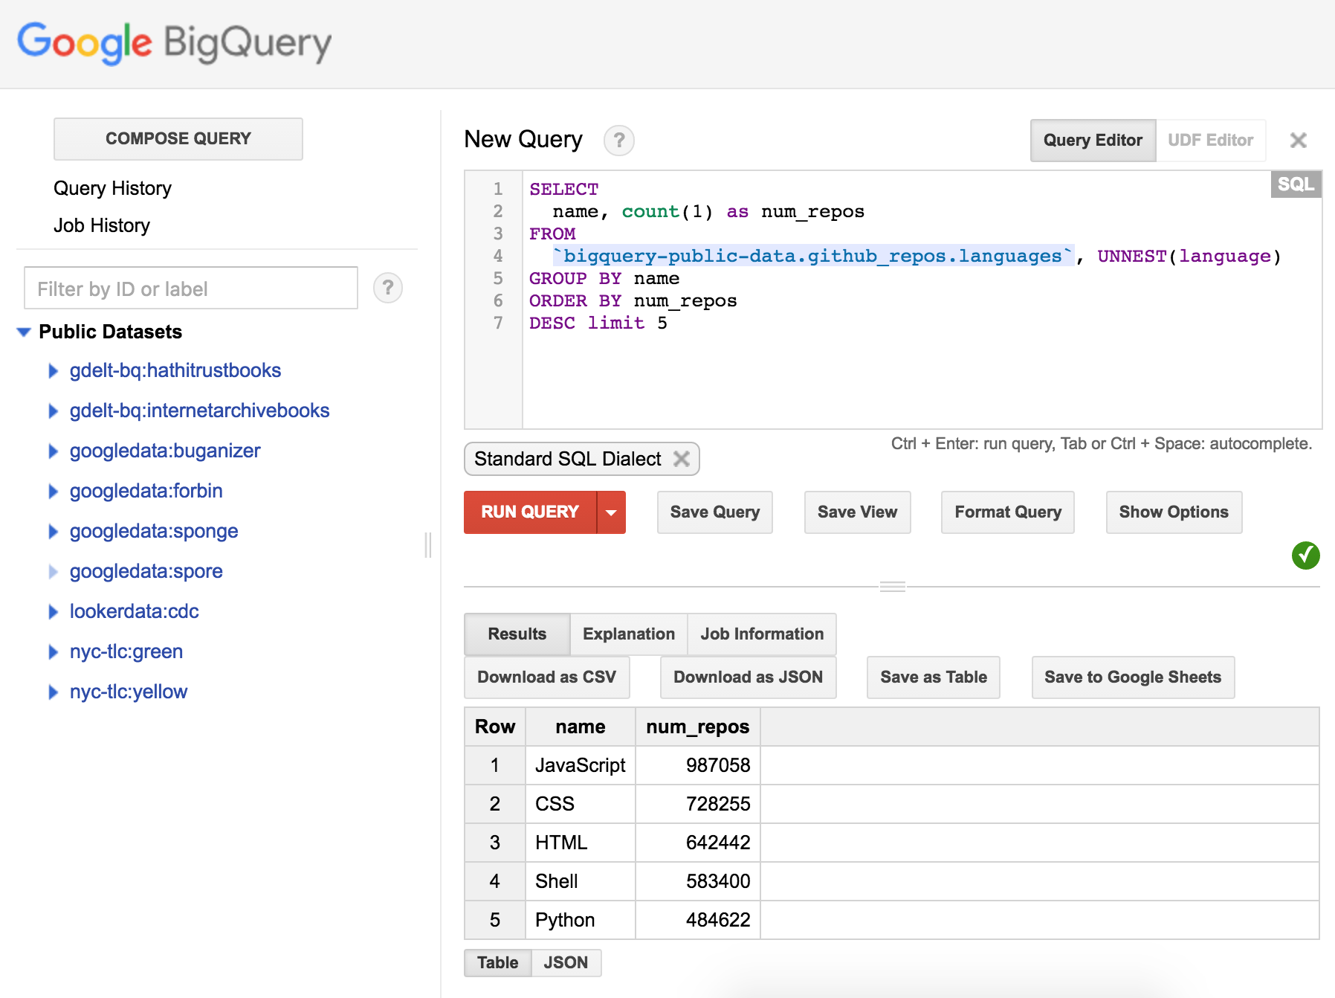
Notes:
In the 2010s, cloud-scale distributed computing platforms emerged to handle storing and processing of data across thousands of computers in a data center.

Slide 21
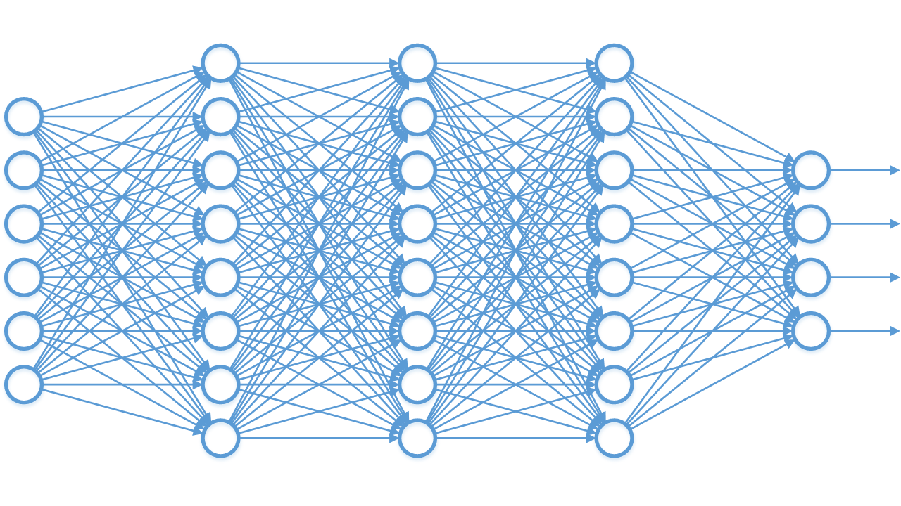
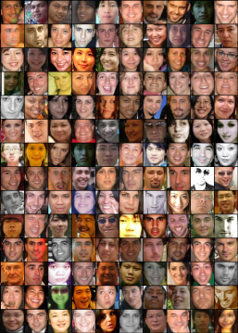
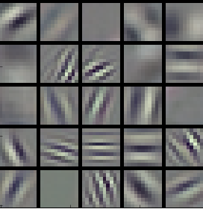
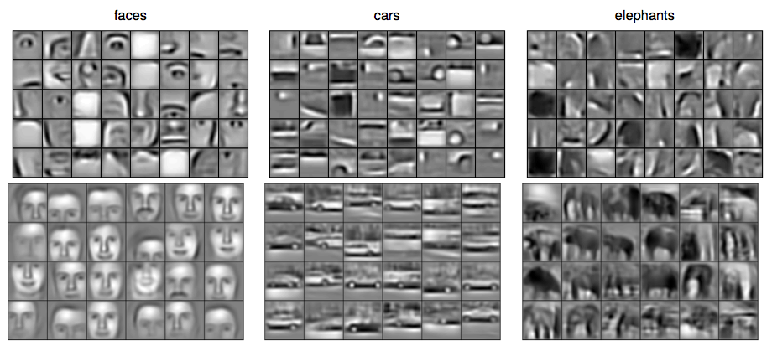
Human
Cat
Dog
Car
Notes:
This decade also ushered in the era of deep learning – training deep neural networks on very large data sets to classify and predict much more complex patterns of data.

Slide 22

Notes:
As we move into 2020s, the explosion of data from the internet of things is leading to a need for new methods to store and process data.

Slide 23

Notes:
In addition, the demand for modern data analysis has made data science one of the most in-demand professions of the 21st century.

Slide 24

Notes:
In the next decade and beyond, the field of data science will continue to grow and will likely evolve into data-driven artificial intelligence.
A new era of data that will almost certainly change our world in more ways than we could possibly imagine.

Slide 25
Overview

Slide 26
Purpose
To learn about data as a foundation for data science
Notes:
[1] The purpose of this course is to learn about data as a foundation for data science.
It might seem obvious, but half of data science is data, …
… so as you can imagine, it’s really important to have a thorough understanding of data to be successful with data science.
This course was designed to provide you with that foundational knowledge.

Slide 27





Overview
Data
Types of Data
Data Types
Tabular Data
Data Life Cycle
Notes:
As an overview of this course:
[1] First, we’ll learn about data.
We’ll learn what it is… and why it’s important for data science.
[2] Next we’ll learn about the various types of data we encounter in data science …
… including categorical and numerical data.
[3] Then we’ll learn about data types …
… and how we represent and store various kinds of data in a computer.
[4] Next, we’ll learn about data structures …
… and how providing structure to data gives it additional context and meaning.
[5] Then, we’ll learn about tabular data …
… tables of data organized into rows and columns that allow us to perform queries.
[6] Finally, we’ll learn about the data life cycle.
We’ll learn about the journey of data as we move from raw data to actionable insight.

Slide 28
Prerequisites
No prerequisite courses
No required software
Notes:
[1] There are no prerequisites for this course.
We will assume you are new to data, data science, and computer programming throughout this entire course.
[2] In addition, you won’t need to install any software on your computer to complete this course.
We’ll keep everything in this course as simple and easy to understand as possible.

Slide 29
Website
http://matthewrenze.com/courses/intro-to-data
Notes:
[1] All of the content for this course can be found at the following URL.
This includes videos, slides, quizzes, exercises, and more.
If you haven’t already done so, please visit this webpage now and bookmark it for future reference.

Slide 30
Learning Outcome
You will understand data in the context of data science.
Notes:
[1] By the end of this course, you will understand data in the context of data science.
You’ll understand data types, data structures, tabular data, and the data life cycle.
This foundational knowledge will help you to understand all of the concepts in the remaining courses in this series on data science.
Alright… we’ve got a lot to cover in this course… so let’s get started!

Slide 33
Renze Consulting presents:

Slide 35
A Data Science Made Simple course

Slide 37

Intro to Data for Data Science
Matthew Renze
Data Science Consultant
matthewrenze.com

Slide 38

Intro to Data for Data Science
Matthew Renze
Data Science Consultant
matthewrenze.com

Slide 39


Slide 40

Intro to Data for Data Science
Matthew Renze
Data Science Consultant
http://matthewrenze.com
Notes:
Hi. I’m Matthew Renze, data science consultant, author, and public speaker.
Welcome to this introductory course on data for data science.
In this course, we’ll learn about data as a foundation for data science.
We’ll learn what data is, why it’s important, and how it is used within data science.
In addition, we’ll learn about data, data types, data structures, tabular data, and the data life cycle, all from the perspective of data science.
But first, let’s begin with a quick story.

